Slide 1
E-vault Using Blockchain To Store And Transfer Legal Records
Team: 55
2103A52135 Goli Chandana 2103A52058 Mohammed Mudassir Hussain 2103A52069 Syed Khaja Mukarram Ajaz 2103A52159 Mohammed Naveed Sharief 2103A52171 Thangallapally Nihal 2103A52162 Vuppula Vashista
Mentor and Trainer :
Dr. Balajee Maram
Associate Professor, School of CS&AI

Slide 2
Abstract
This project implements a secure blockchain-based vault system for legal document storage, verification, and transfer. Leveraging immutable distributed ledger technology with local encryption, E-Vault ensures tamper-proof document integrity while providing a user-friendly interface. The system addresses critical challenges in legal record management through cryptographic validation, transparent audit trails, and secure ownership transfer mechanisms.

Slide 3
Introduction
E-vault is a blockchain-based solution designed to address the critical need for secure and transparent management of legal records. By leveraging distributed ledger technology, the system ensures document immutability and traceability while providing an intuitive user experience. The project demonstrates how blockchain can be practically applied to legal record management, offering enhanced security and trust compared to traditional centralized systems.

Slide 4
Motivation
The legal industry faces significant challenges with document security, integrity verification, and establishing clear chains of custody. Traditional systems often struggle with:
Ensuring documents haven't been tampered with
Providing verifiable proof of document ownership
Creating transparent transfer histories
Maintaining document integrity over time
E-vault addresses these challenges by implementing blockchain technology as a foundation for secure legal record management.

Slide 5
Literature Review
Blockchain Applications in Document Management
Blockchain technology has emerged as a promising solution for document management systems. Zheng et al. (2018)[1] highlight blockchain's immutability and distributed consensus as key features for ensuring document integrity. However, they note scalability challenges when handling large document volumes. Hash-based verification techniques, as proposed by Wang et al. (2020),[2] enable document validation without revealing sensitive content, particularly valuable for legal records where confidentiality is paramount.

Slide 6
Literature Review
Advancements in Legal Document Systems
Recent developments have focused on enhancing document transfer mechanisms. Kumar and Smith (2022)[3] introduced a blockchain-based transfer protocol with multi-signature authorization to ensure secure document custody changes. Meanwhile, Chen et al. (2021)[4] addressed privacy concerns through zero-knowledge proofs, allowing document verification without revealing underlying data. These approaches, while effective, often require complex infrastructures. Our work builds upon these foundations while prioritizing simplicity and accessibility through a streamlined user interface and localized implementation.

Slide 7
Existing Method v/s Proposed Method
Traditional document management systems rely on centralized authorities and databases, creating single points of failure and requiring trust in system administrators. Our proposed E-vault solution leverages blockchain technology to distribute trust across the network, ensuring documents cannot be altered without detection. The system uses cryptographic hashing for document verification and smart contract principles for secure ownership transfer, creating a tamper-evident audit trail for all document transactions.

Slide 8
Existing Method v/s Proposed Method
Table 1: Existing v/s Proposed methods
Feature | Traditional Systems | Cloud-Based Systems | E-Vault Blockchain
Tamper Resistance | Low | Medium | High
Data Ownership | Service Provider | Service Provider | User
Verification | Manual | Digital Signatures | Cryptographic Proof
Transfer Security | Low | Medium | High
Audit Trail | Limited | Centralized Logs | Immutable Record
Implementation | Complex | Moderate | Simple Local Setup
Cost | High Maintenance | Subscription-Based | One-time Setup

Slide 9
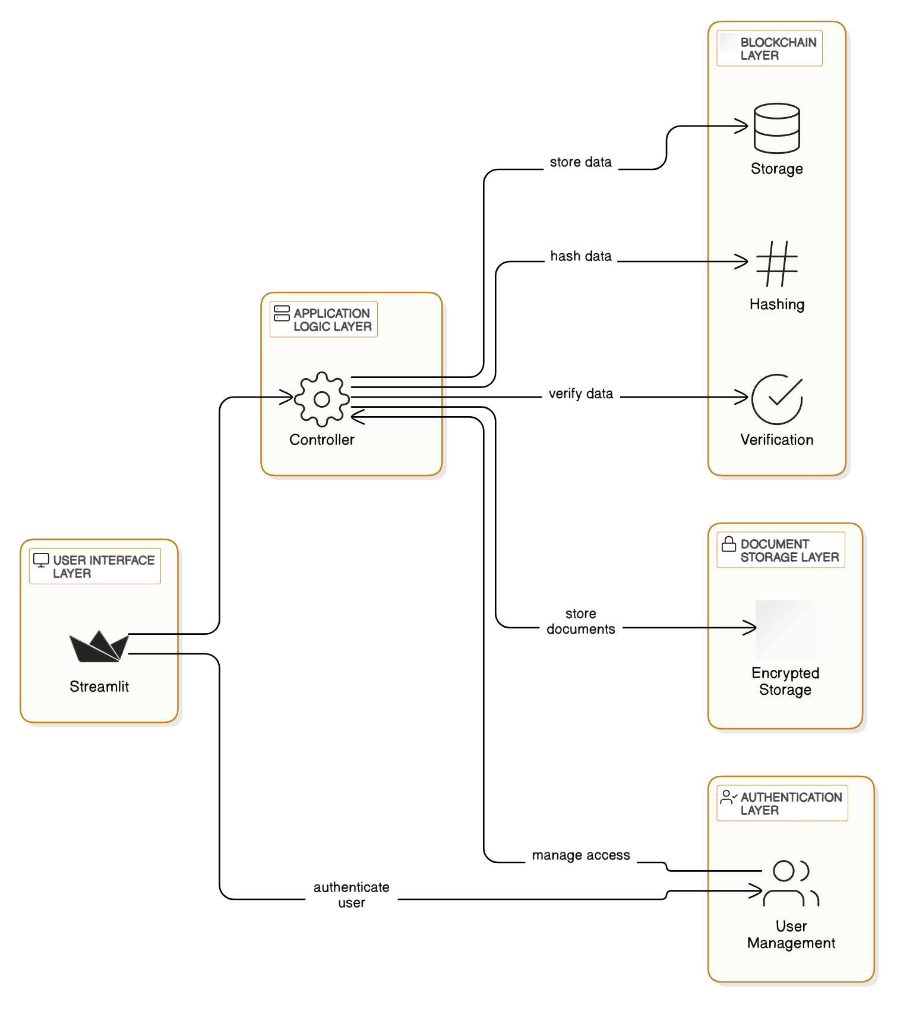
Existing Method v/s Proposed Method
Figure 1: Proposed plan

Slide 10
Objective
Primary Goal: To develop a secure, blockchain-based system for storing and transferring legal records that ensures document integrity, ownership verification, and transparent history tracking.
Sub-Goals:
Implement a lightweight blockchain solution for document verification using cryptographic hashing and proof-of-work
Create a secure document storage system with encryption and access control mechanisms
Develop a transparent document transfer mechanism with immutable ownership history
Build a user-friendly interface using Streamlit to make blockchain technology accessible to legal professionals
Establish a comprehensive audit trail for all document activities

Slide 11
Document Storage Structure
Our system manages multiple data structures:
User Records: Authentication credentials and access permissions
Document Metadata: Name, type, ownership, timestamps, and access history
Document Content: Encrypted binary data with secure storage
Blockchain Records: Transaction history, validation hashes, and proof-of-work
Session Data: Temporary authentication tokens and user state

Slide 12
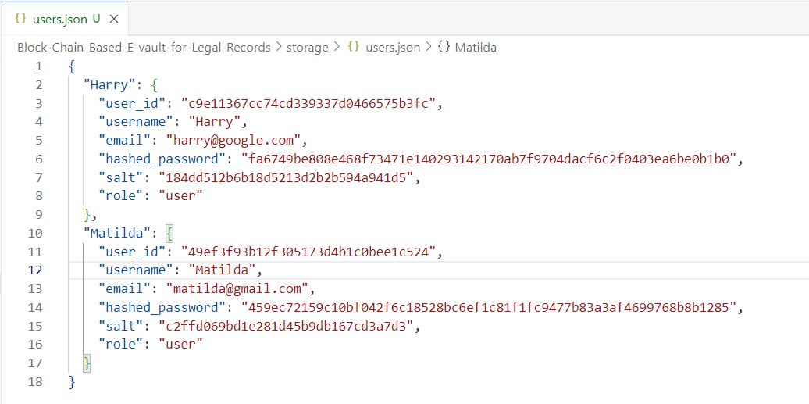
Document Storage Structure
Figure 2: Users Info: Harry and Matilda

Slide 13
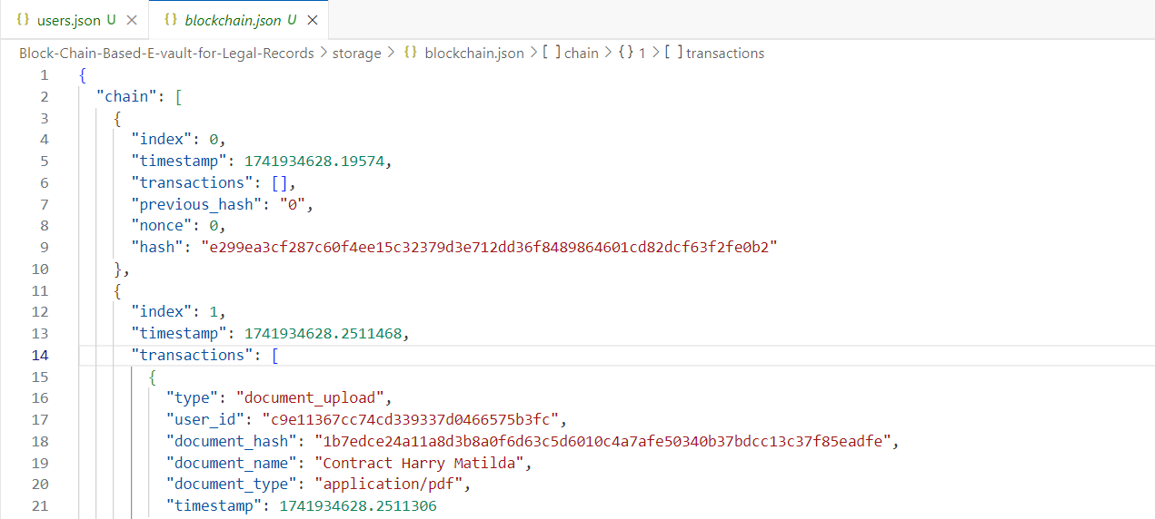
Document Storage Structure
Figure 3: Blockchain: All Transactions are tracked

Slide 14
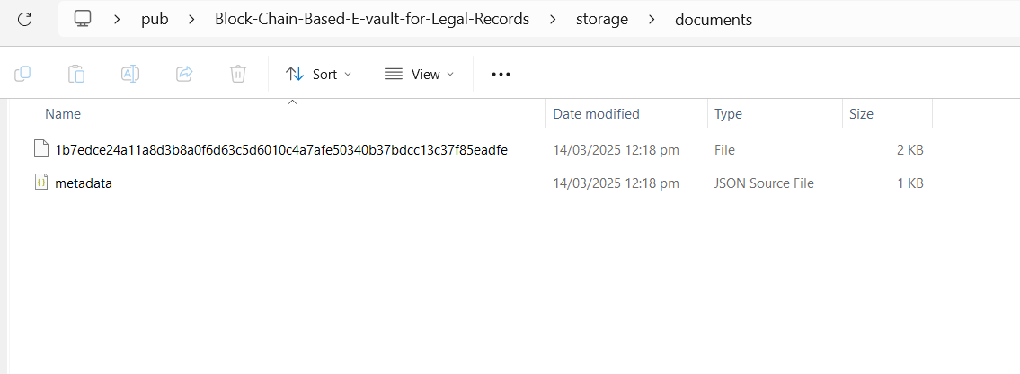
Document Storage Structure
Figure 4: Documents Stored as Encrypted

Slide 15
Methodology: Technical Implementation Approach
Blockchain Core Development:
Custom Python implementation with proof-of-work consensus
Block structure with transaction batching and hash validation
Document Management:
AES encryption for document security
Hash-based verification for content integrity
Segregated storage for metadata and encrypted content
User Interface:
Streamlit-based responsive design
Session-based authentication with token validation
Intuitive document upload, view, and transfer workflows

Slide 16
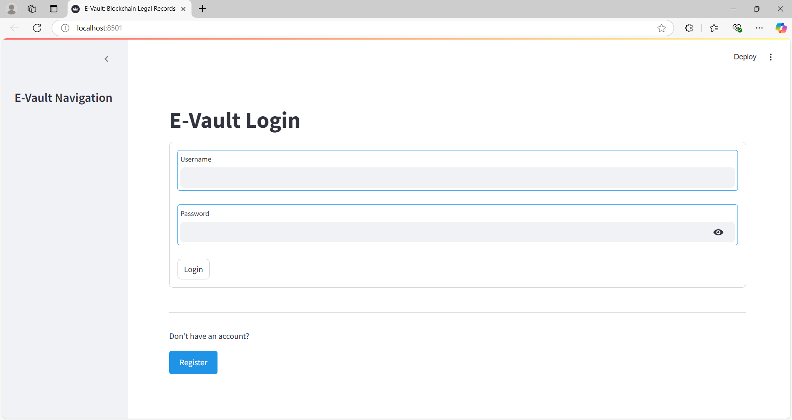
RESULTS:
Figure 5: Landing Page

Slide 17
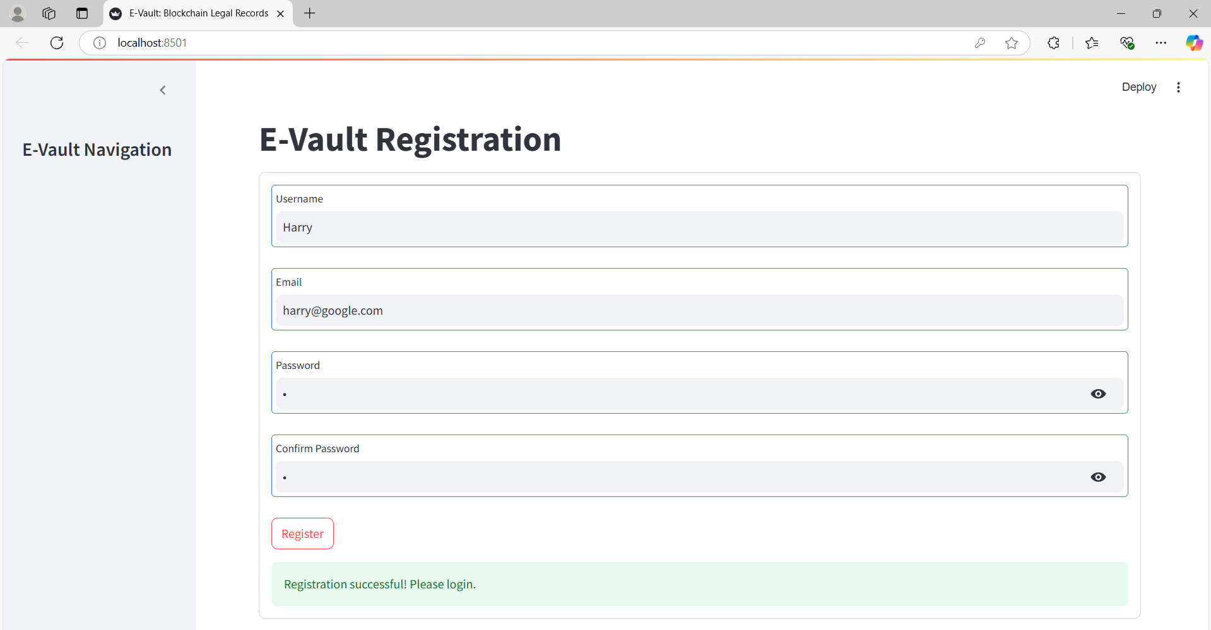
RESULTS:
Figure 6: Registration Page: Harry registered

Slide 18
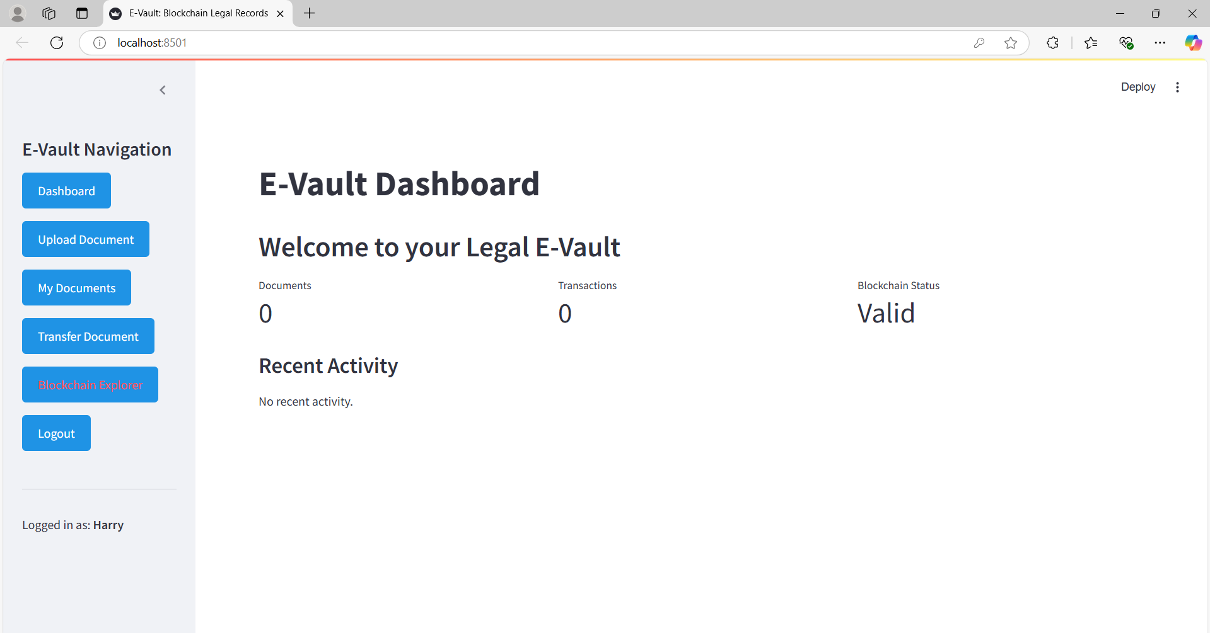
RESULTS:
Figure 7: Initial Dashboard: Harry

Slide 19
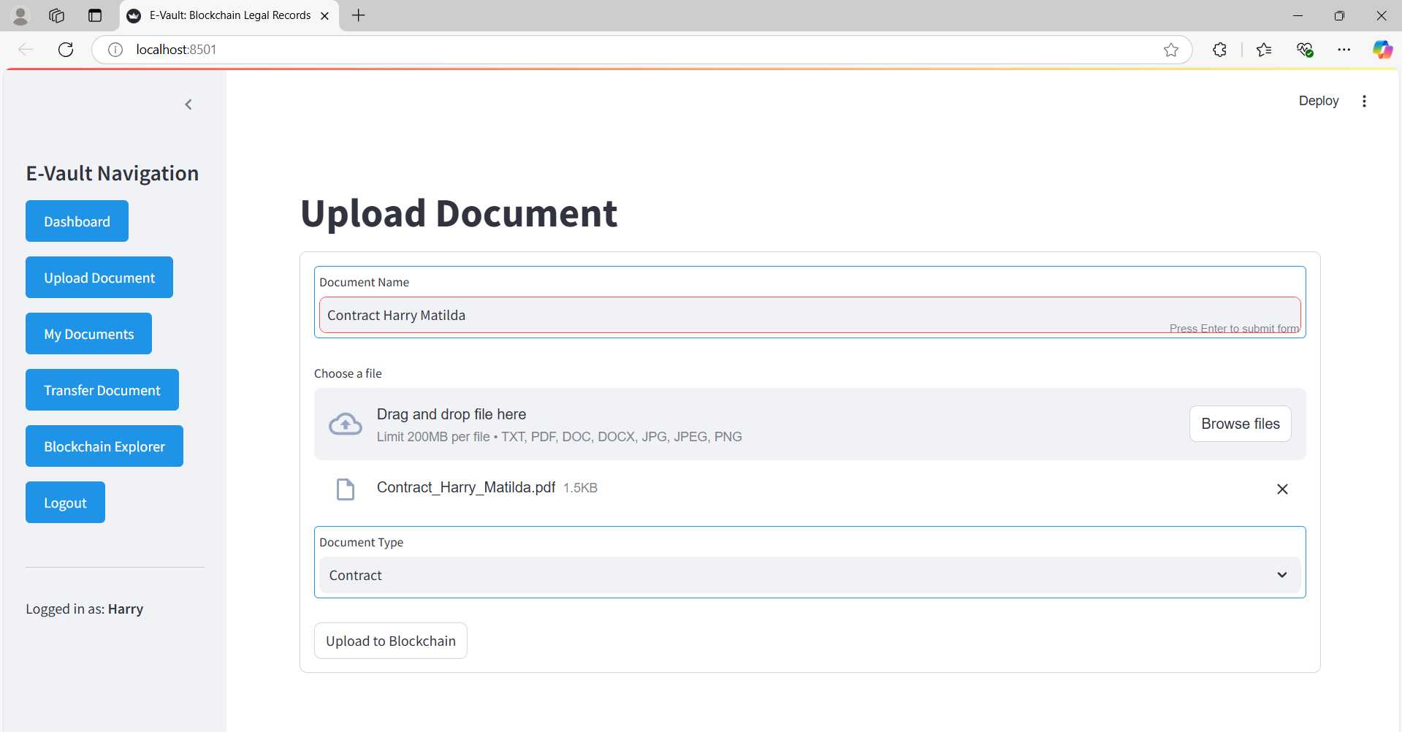
RESULTS:
Figure 8: Uploading Document\Contract: Harry

Slide 20
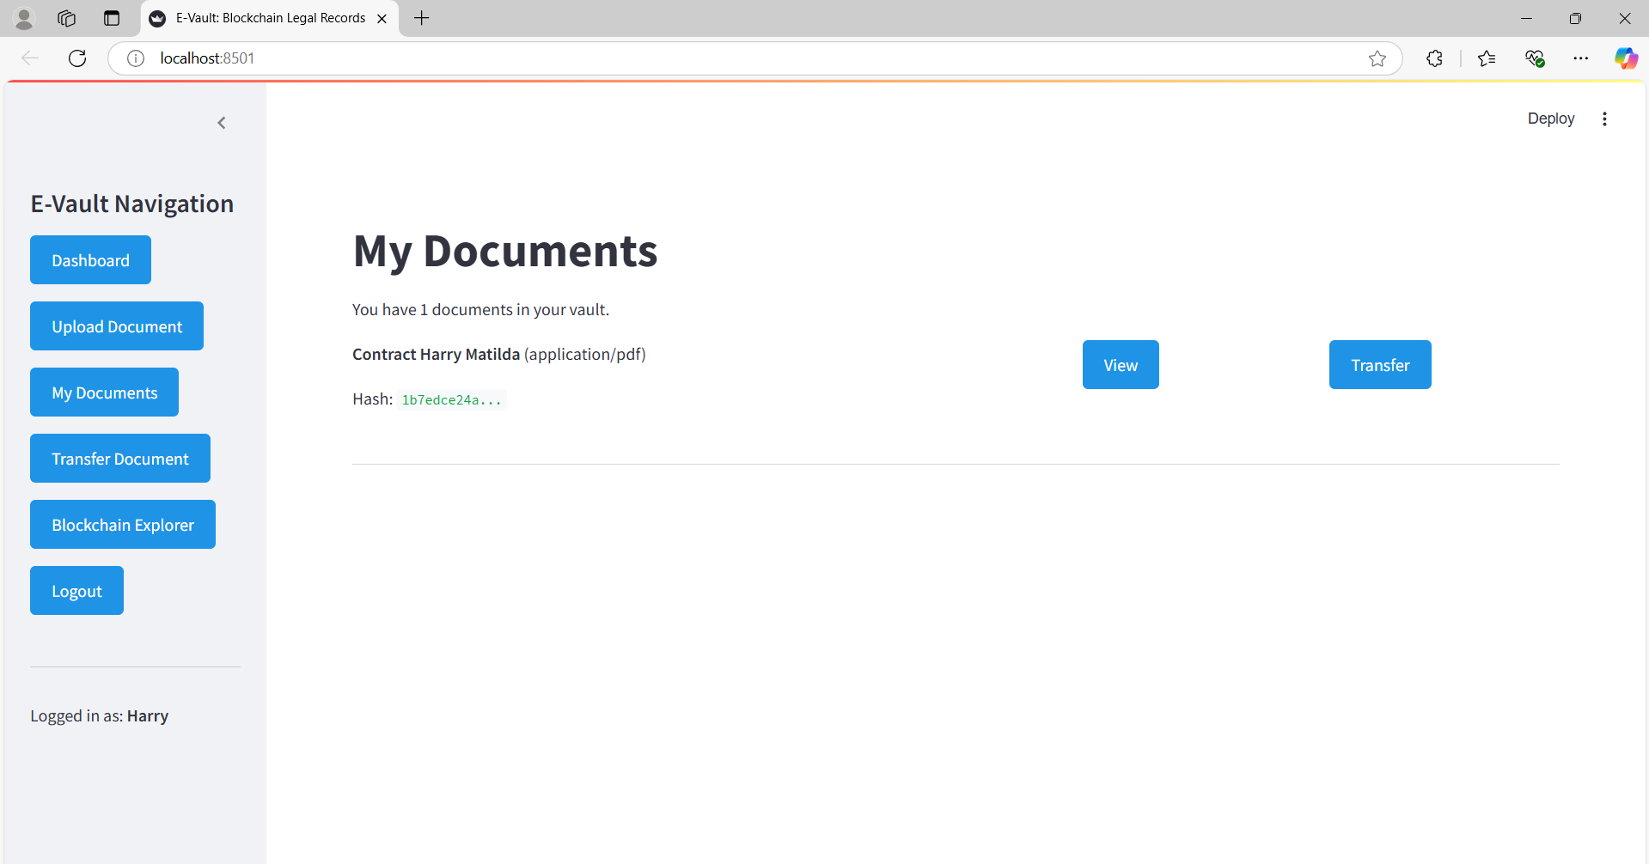
RESULTS:
Figure 9: My Documents Page: Harry

Slide 21
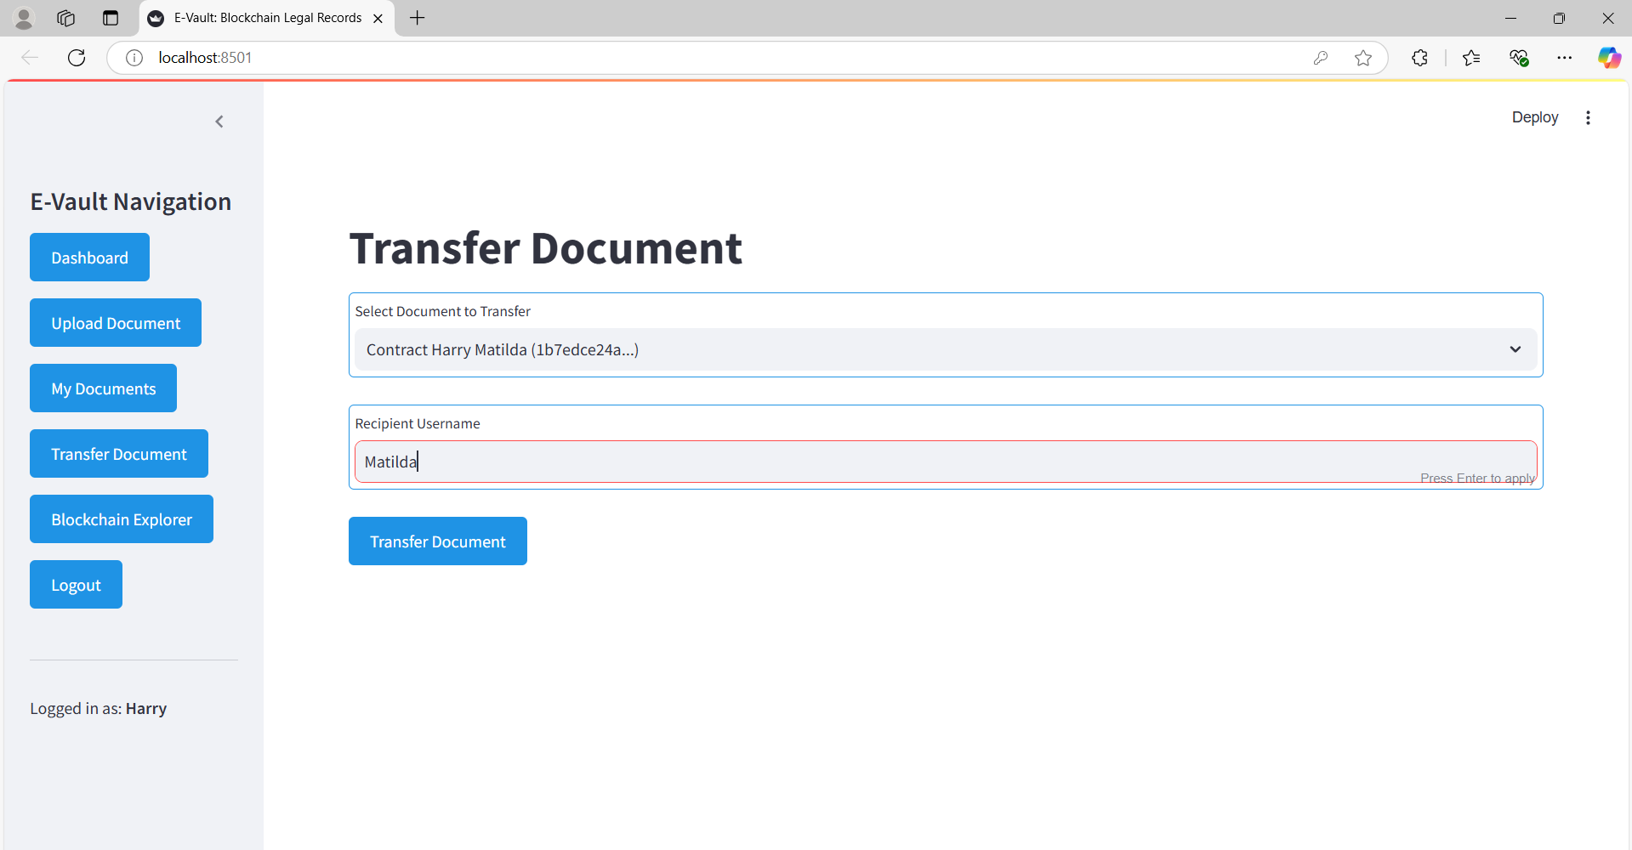
RESULTS:
Figure 10: Transfer Document: Harry transferring to Matilda

Slide 22
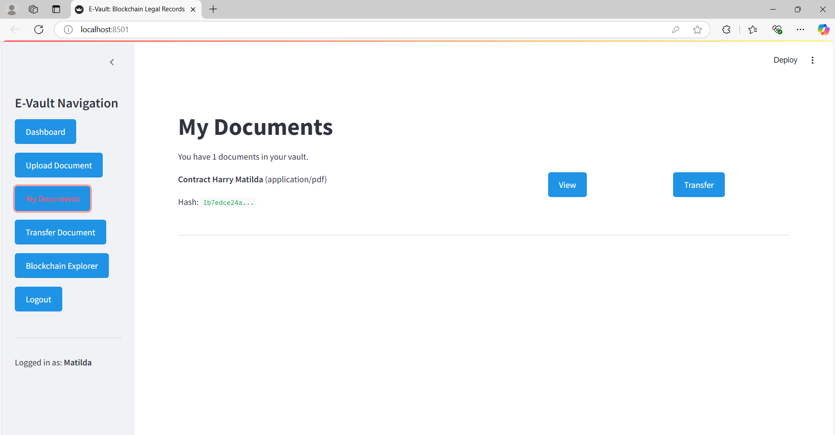
RESULTS:
Figure 11:My Documents Page: Matilda –User 2. File Transferred

Slide 23
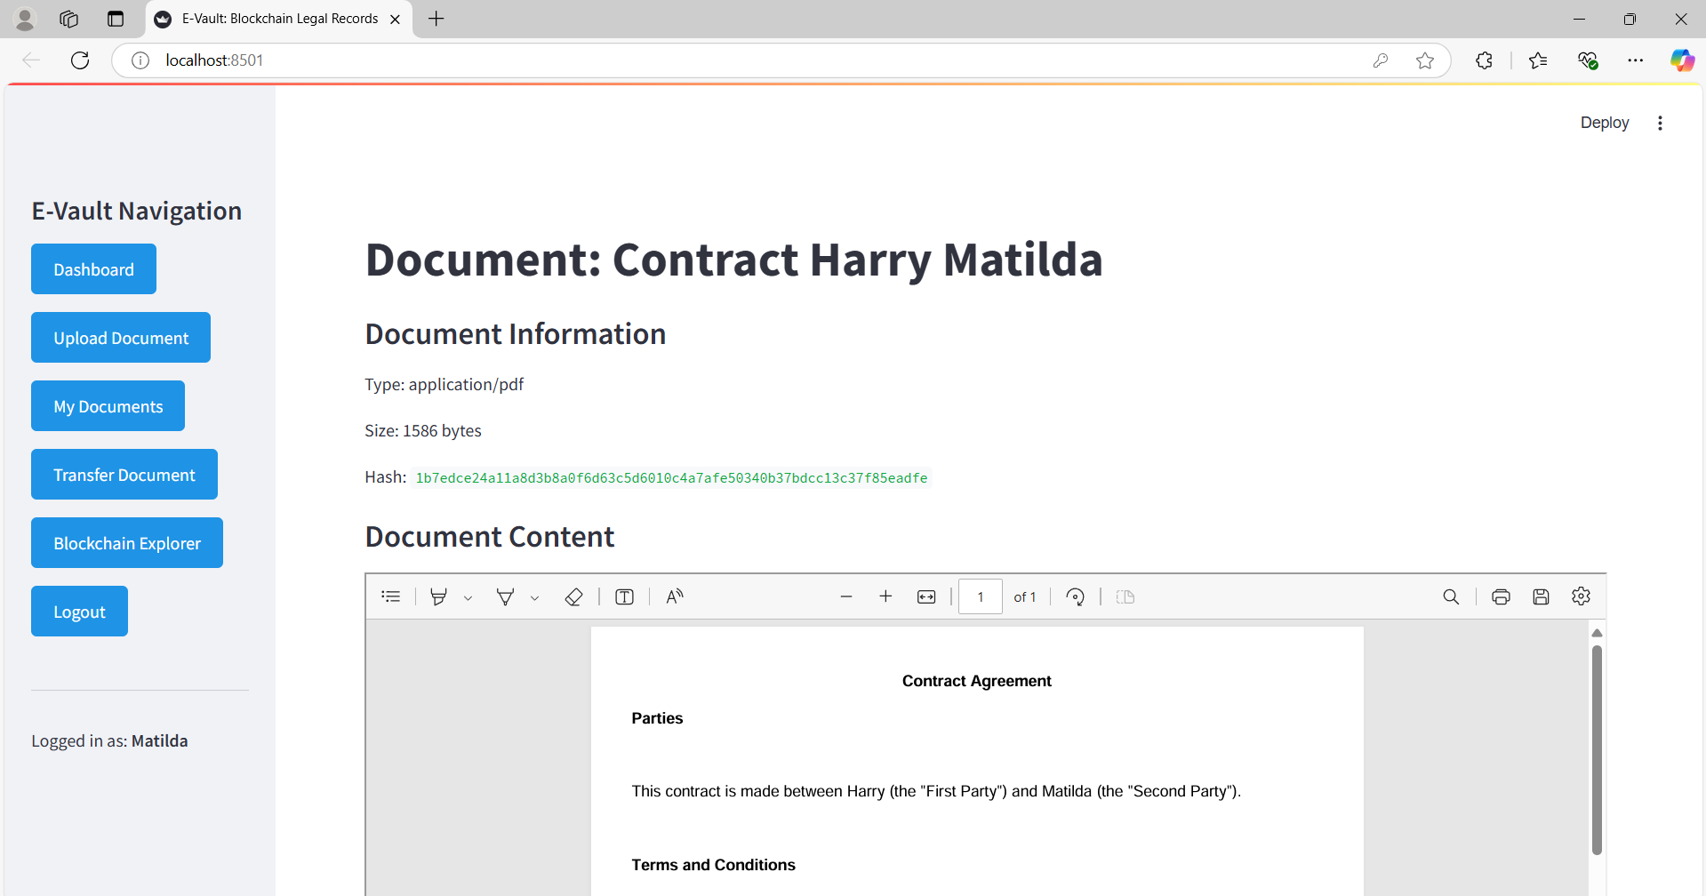
RESULTS:
Figure 12: Viewing the Document: Matilda –User 2.

Slide 24
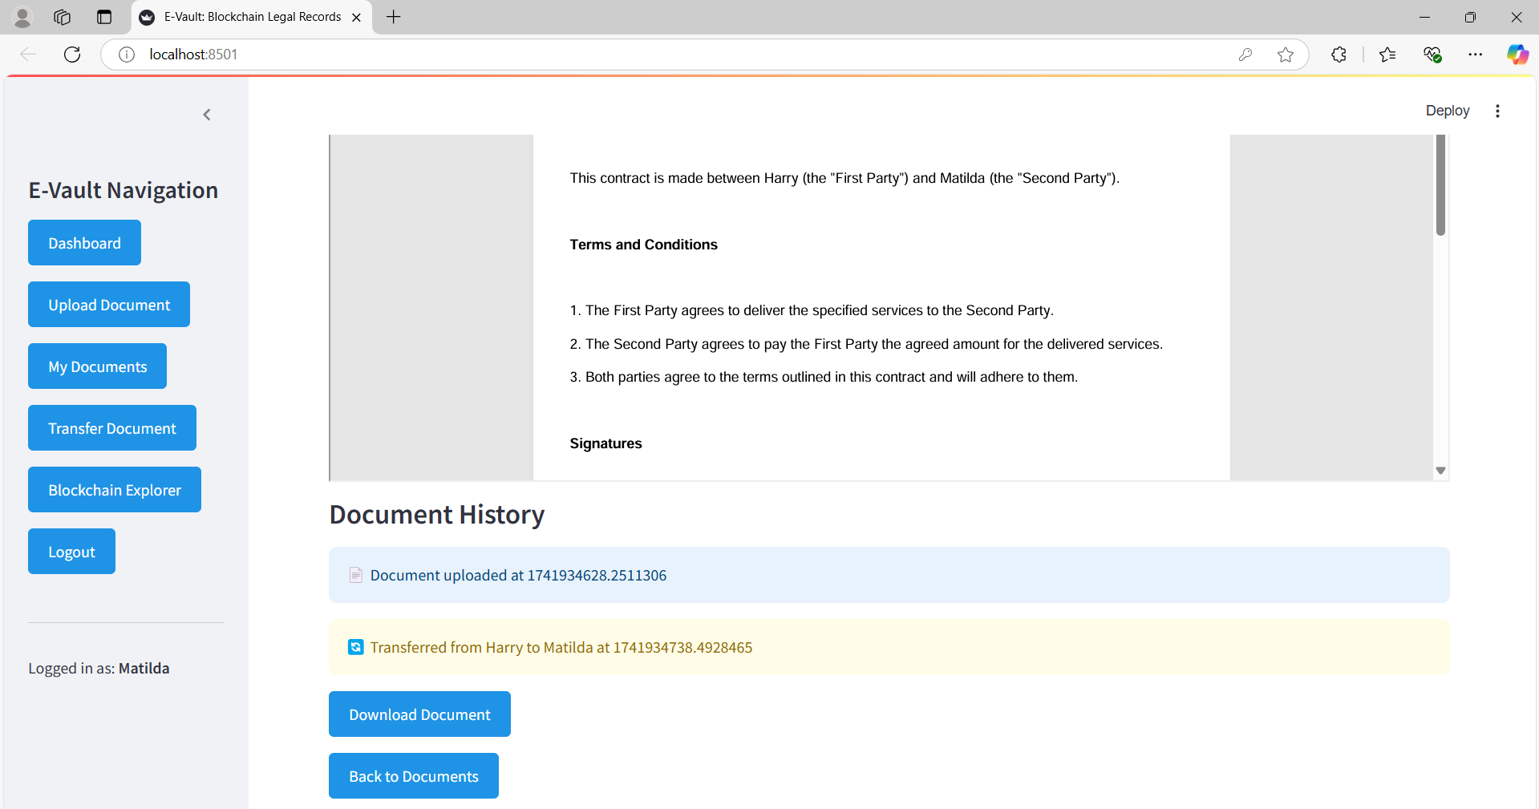
RESULTS:
Figure 13: Document History is shown below while viewing the document: Matilda –User 2.

Slide 25
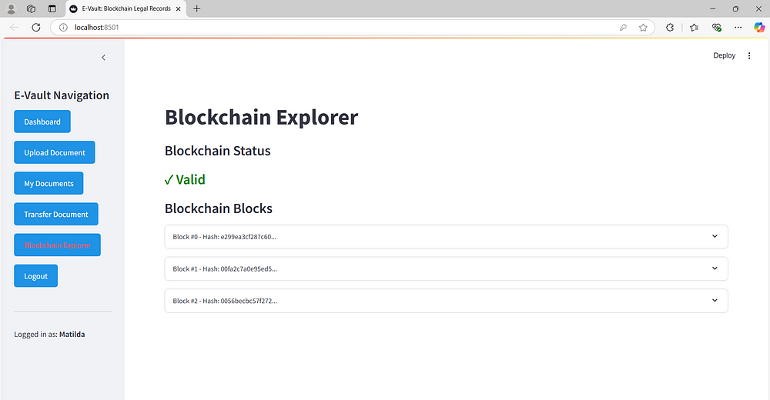
RESULTS:
Figure 14: Blockchain explorer

Slide 26
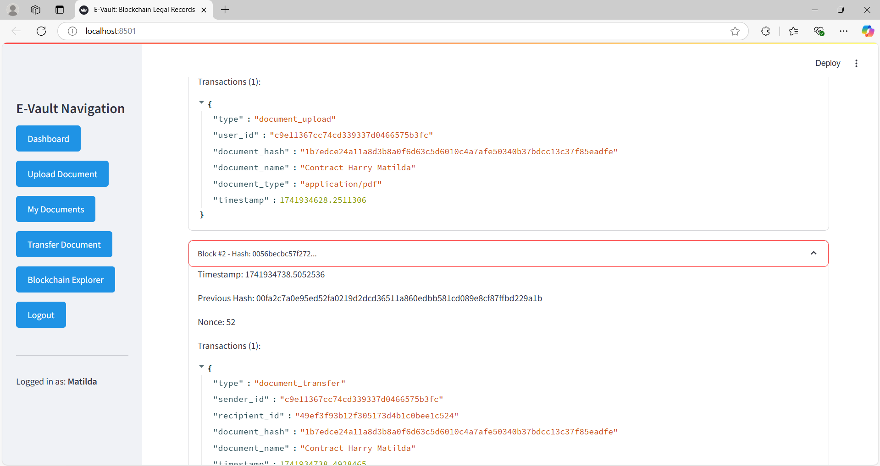
RESULTS:
Figure 15: Blockchain explorer: Tracks all transactions

Slide 27
CONCLUSION
Successfully implemented a functional blockchain-based legal records management system
Demonstrated practical application of blockchain for document integrity
Created secure document transfer mechanisms with ownership validation
Developed an intuitive interface accessible to non-technical users
Provided comprehensive document history tracking and verification
Established a foundation for enhanced legal document management
Balanced security requirements with usability considerations

Slide 28
FUTURE SCOPE
Multi-signature approvals: Require multiple parties to authorize document transfers
Smart contract integration: Automate legal workflows with conditional logic
Distributed deployment: Extend to multiple nodes for true decentralization
Mobile application: Develop companion mobile app for on-the-go access
Advanced search capabilities: Implement content-based document search
Regulatory compliance modules: Add jurisdiction-specific compliance validation
Integration with legal practice management systems: Connect with existing legal workflows

Slide 29
References: Academic & Technical
[1] Zheng, Z., et al. (2018). Blockchain challenges and opportunities: A survey.
[2] Wang, S., et al. (2020). A blockchain-based framework for data sharing with fine-grained access control in decentralized storage systems.
[3] Kumar, A., & Smith, J. (2022). Secure document transfer protocols using blockchain technology.
[4] Chen, Y., et al. (2021). Privacy-preserving document verification using zero-knowledge proofs.
[5] Nakamoto, S. (2008). Bitcoin: A peer-to-peer electronic cash system.
[6] Streamlit Documentation (2023). Building data applications with Streamlit.
[7] PyCryptodome Documentation (2023). Python cryptography toolkit.

Slide 30
THANK YOU
GitHub Link: https://github.com/Naveed-4/Block-Chain-Based-E-vault-for-Legal-Records

